Slide 1
Course : Computational Physics
Effective Period : April 2022
Basic Circuit Design and Simulation Session 2

Slide 2
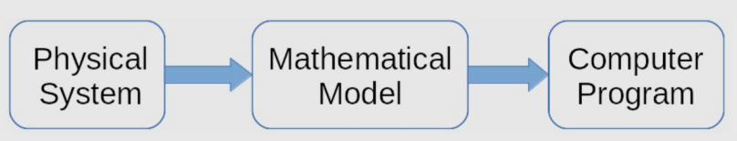
Objective and Outline
LO : Implement a computational simulation of basic electrical circuits using Python programming language
In this course we will be simulating power electronic circuits using Python. However, the Python part is not heavy. This course is ideal for students only with a basic knowledge of network theory and programming to get started with simulating simple power electronic circuits. The course contains a basic introduction to the Python Power Electronic (PPE) and describes how to use it to simulate simple rectifier (RLC) circuits.
In this session, we will start exploring a simulation concept using Open-Source Python Power Electronics
Download : https://www.pythonpowerelectronics.com/
Outline
Introduction on voltmeter and ammeter
Drawing circuits in a spreadsheet
Understanding parameter of simulation
Running a minimalistic circuit simulation
Simulation Concept

Slide 3
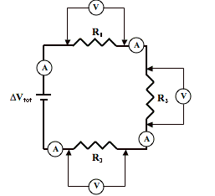
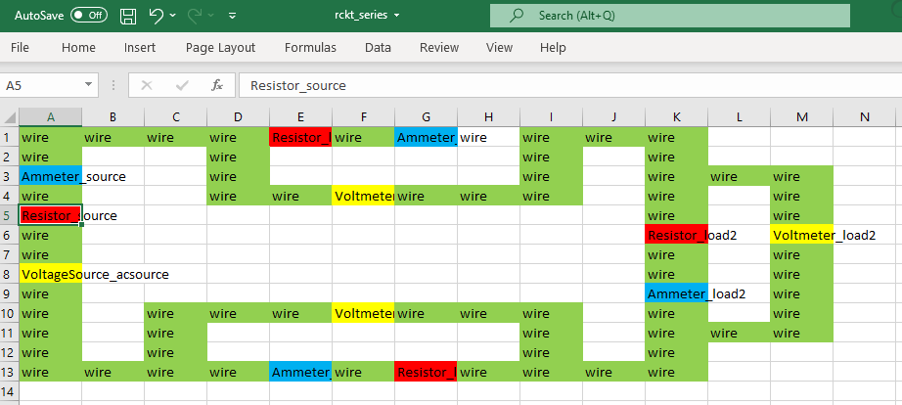
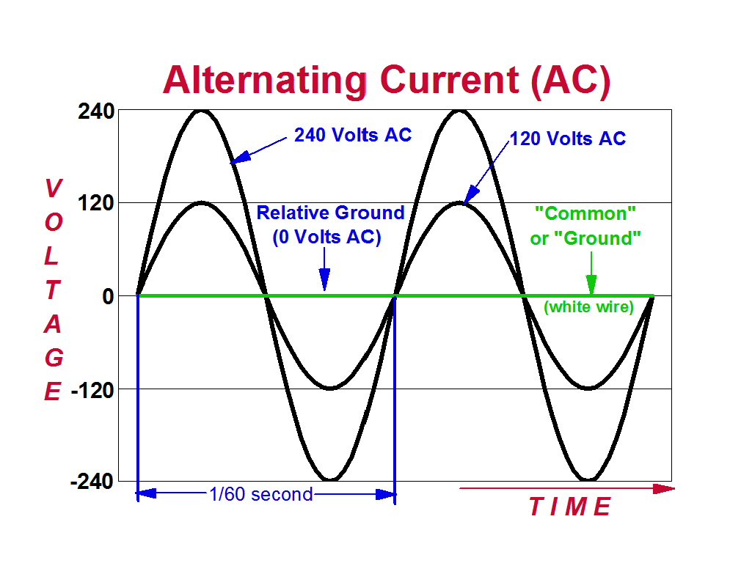
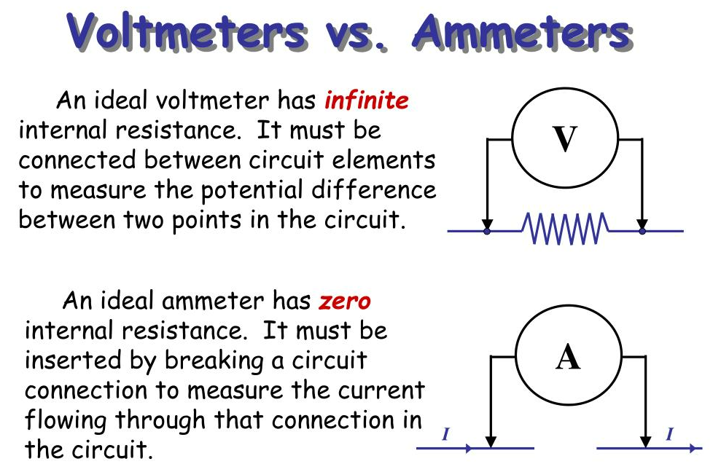
Circuit Topology and A/C Current
The topology is the graphical representation of electric circuits, showing the network of interconnections of the circuit components. Components in the same topology will have specific values or ratings. As we don’t need too complicated circuit, this course will use ms. Excel to draw the circuit
Alternating current (AC) is the flow of electric charge that periodically reverses direction. If the source varies periodically, the circuit is known as an alternating current circuit. Examples include the commercial and residential power that serves so many of our needs.
For an alternating current generator, the current vs. time graph is a sine wave and alternates between positive and negative values
Ammeter : measuring current
Voltmeter measuring voltage/ potential difference

Slide 4
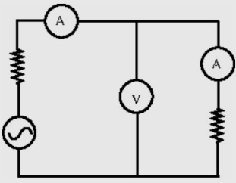
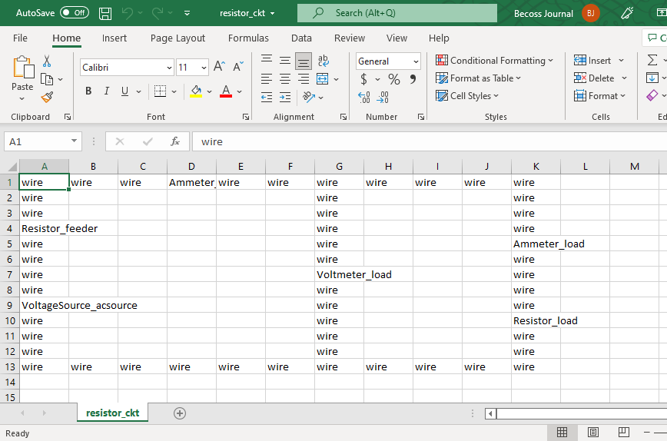
Drawing circuits topology
Open MS Excel and recreate the circuit design
Rules: ComponentType_ComponentName and its case sensitive.
Save in basic .CSV file → D:\...\simulations\basic_resistor_example\resistor_ckt.csv (this is your WORKING DIRECTORY)
ComponentType rules
It is a reserved value
Better to spread the design
junctions are connected by ‘wire’ only
You must complete the loop, incomplete loop is illegal
Wire (connector, has to be adjacent)
Resistor_ComponentName
VoltageSource_ComponentName
Ammeter_ComponentName
Voltmeter_ComponentName
ComponentName Rules:
Do not use another _ or any special character
Combination of string+number is advised
Redundancy ComponentType_ComponentName are unnaceptable

Slide 5
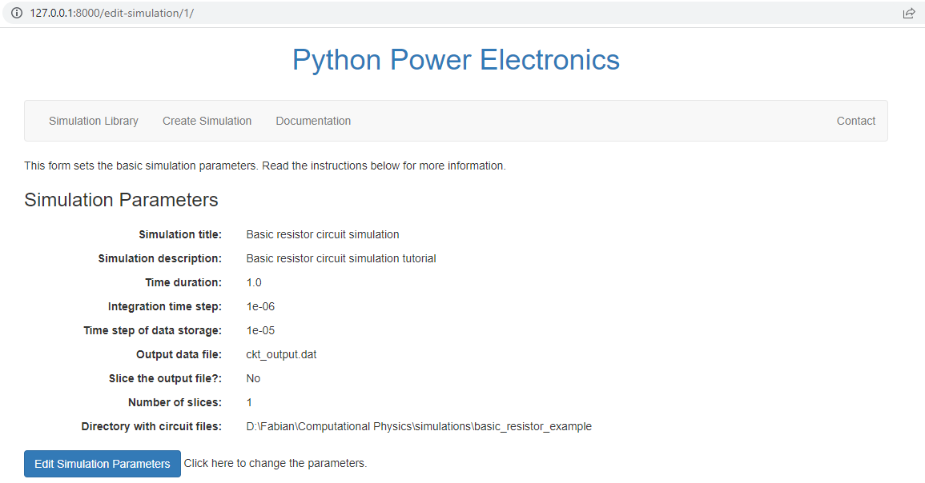
Drawing circuits topology
Webserver launch reminder!
Activate ppe environment
Go to manage.py folder directory (launch file)
If the structured database is already created, run the webserver by python manage.py runserver
Copy http://127.0.0.1:8000/ (or other URL) and run in your browser
Understanding parameter of simulation
Run the PPE webserver
Create Simulation (screen shot is on the next page) :
Simulation Title → title of your simulation → Basic resistor circuit simulation
Time duration → is how long you want your simulation (second): 1.0
Integration time steps → is the discrete sampling rate of the simulation. This is very important: 1e-06
Time Step → saving rate, and have to be > than integration time: 1e-05
Output data file → name.dat or other name
Slice the output file? → no
Number slice → split into number of output into name1.dat, etc: 1
Directory → this is your WORKING DIRECTORY, D:\...\simulations\basic_resistor_example
Solve the warning if there is any, save first, and you can edit later when you need it.

Slide 7

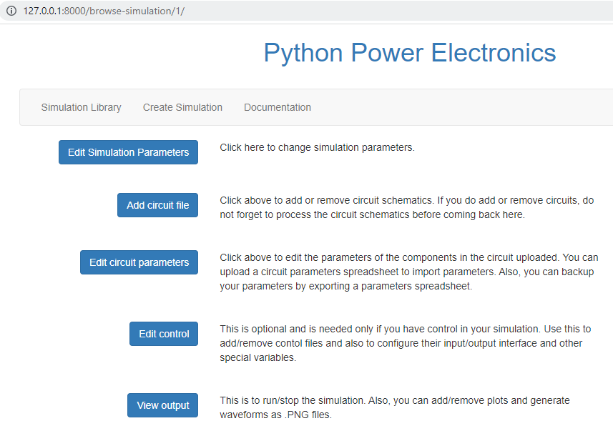
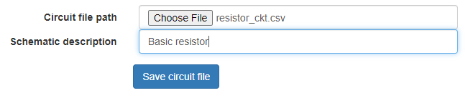
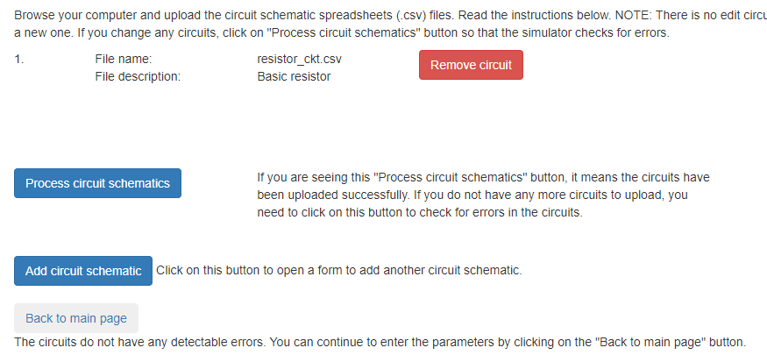
Adding minimalistic circuit simulation
Check is the testfile is created in the WORKING FOLDER
Open and understand the .CSV file structure using word editor
Go to Simulation Library → Load the Simulation → Back to Main Page
Add circuit file → select file → safe circuit file → process circuit schematic
If error, update the .CSV file → process circuit schematic. No need to reupload
Then → Back to main page

Slide 8
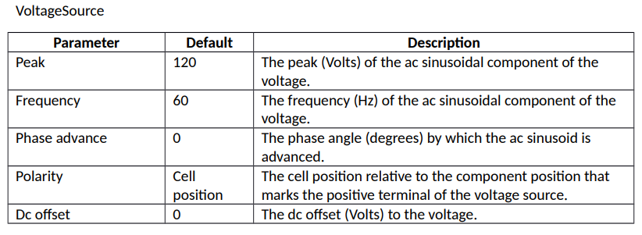
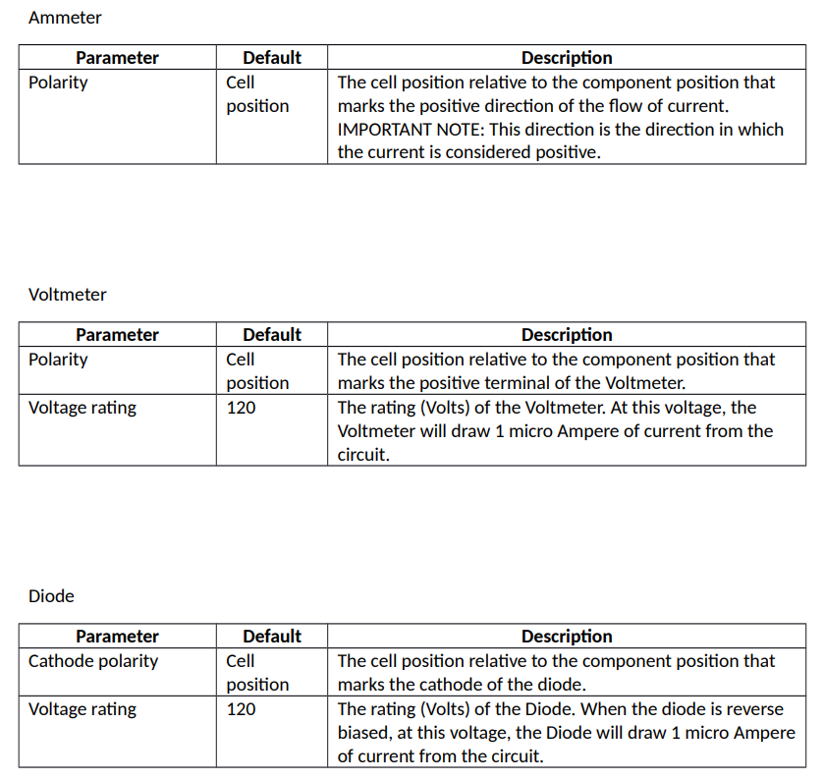
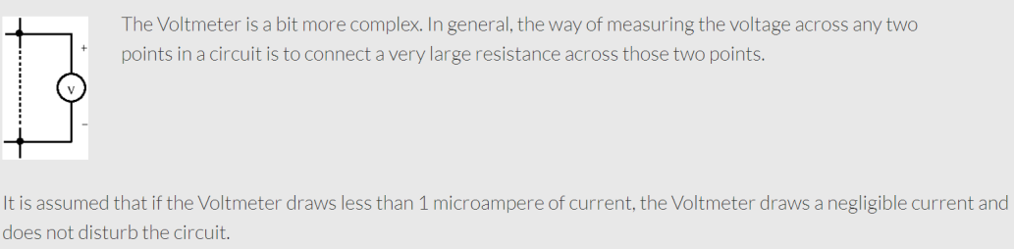
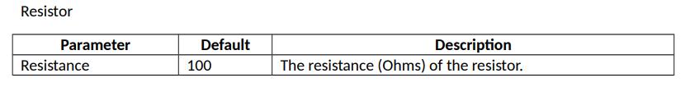
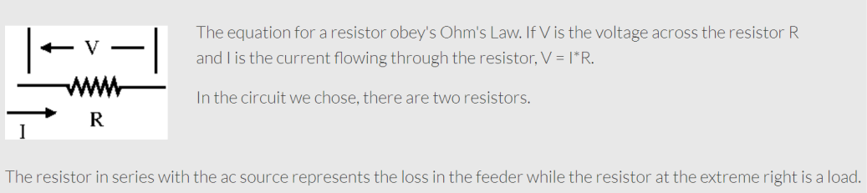
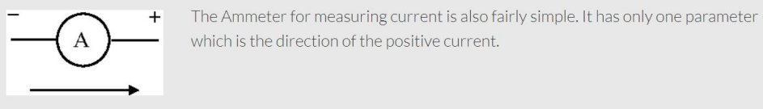
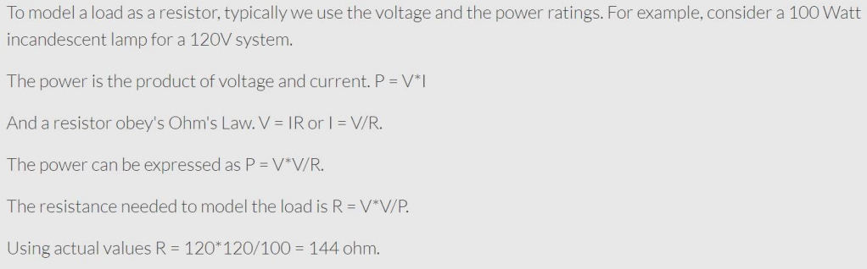
The peak voltage source = actual voltage*sqrt(2).
E.g a 120V system has 144V peak

Slide 9
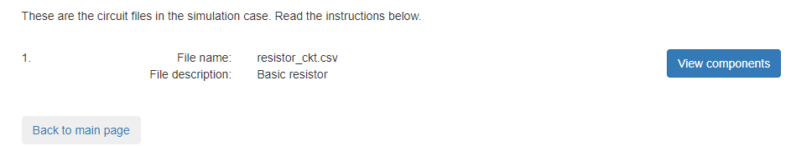
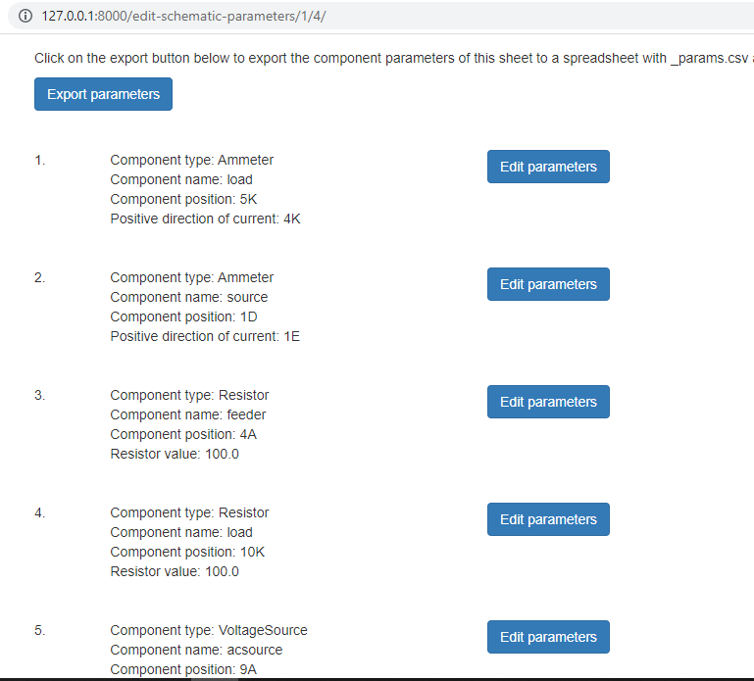
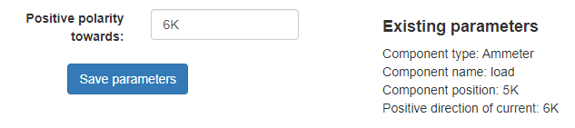
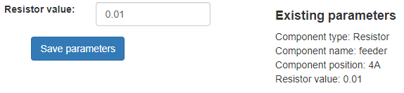
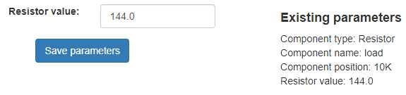
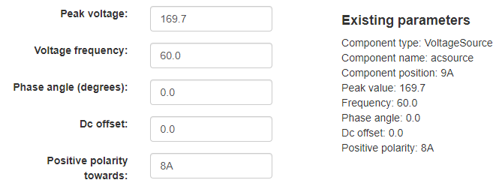
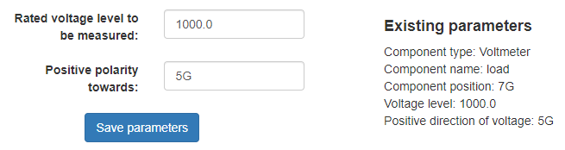
Editing a minimalistic circuit simulation parameter
Click Edit circuit parameters → View component
All component is shown in alphabetical with default value obeying Ohm’s law
Click Edit parameters to change the value and Save. If you put wrong value, the simulation will not accept it
Ammeter_load;
Positive Dir = 6K
Resistor_feeder;
Resistor Value: 0.01
Resistor_load;
Resistor Value: 144 (*)
VoltageSource_acsource;
Peak voltage : 169.70 (**)
Voltmeter_load;
Rated voltage 1000
(*)(**) Cek slide sebelumnya
Then → Back to main page

Slide 10

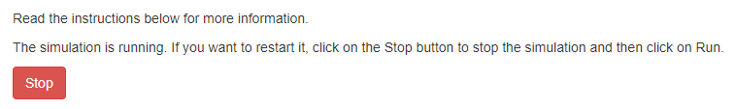
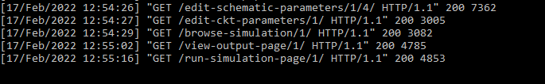
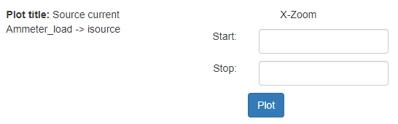
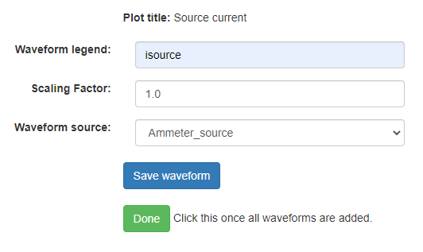
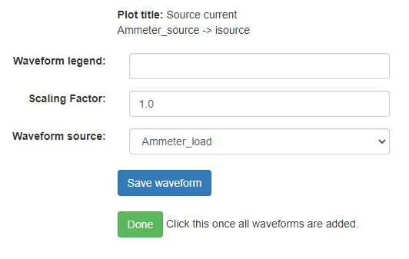
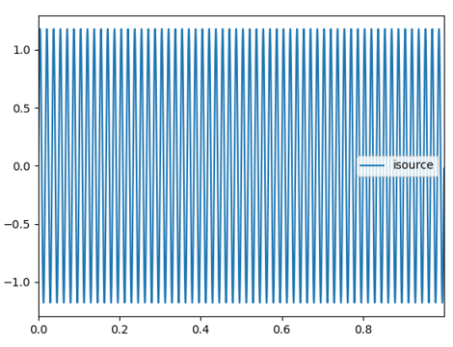
Running the minimalistic circuit simulation
On the main page → View output
Click Run to run the simulation
Check your Anaconda Prompt if there is any error. If no Error then its OK
Click Add plot button to plot your result, follow the setting below → Save → Done → Plot
The plot will be exported in .PNG named Plot title
TRY to play around and analyze the plot! ☺

Slide 11
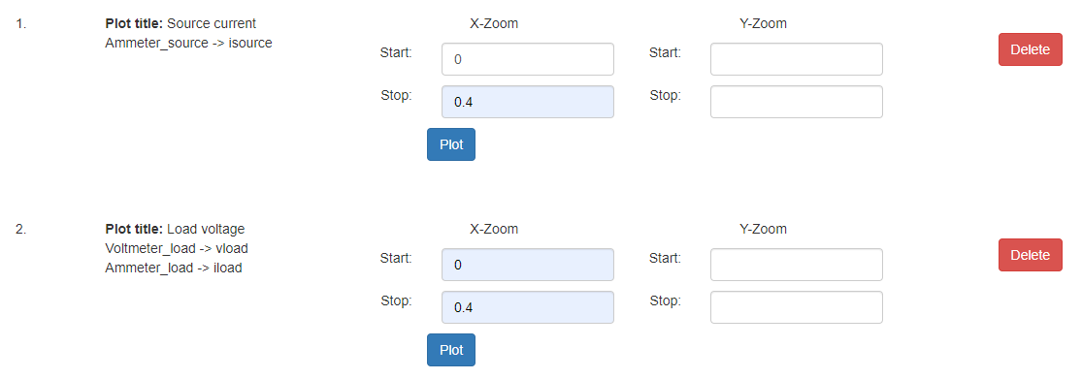
What will happen?
TRY to play around and analyze the plot! ☺

Slide 12
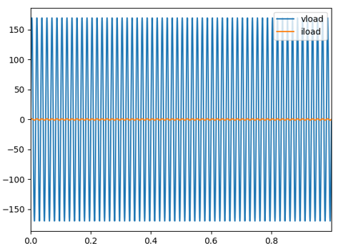
What will happen?
TRY to play around and analyze the plot! ☺
First, limit the x-axis to [0.6 – 0.7] so that you may see smaller details

